Slide 1

ANALYSIS OF NYC JOB OPENING DATASET
By Pallavi Roy

Slide 2

TABLE OF CONTENTS
Objectives
Snap-shot of Raw Data
Data Dictionary
Data Processing Steps
Data Analysis
Dashboard
Insights

Slide 3
OBJECTIVES
Identify the potential sectors
%opening for different service levels
Distribution of full and part time openings
Year-wise Job Opening Trend
Career-level high in demand
Average starting salary of different career level
Biasness in residency requirement

Slide 4
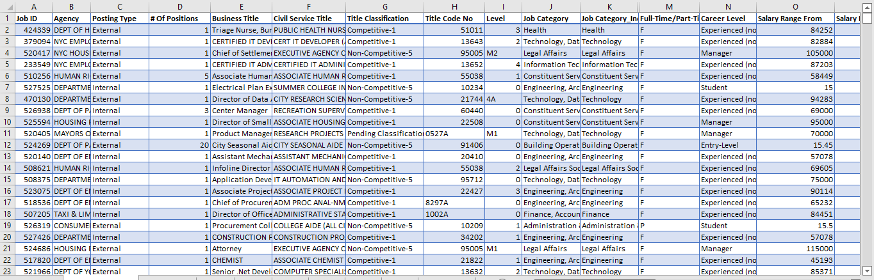
SNAP-SHOT OF RAW DATA

Slide 5
DATA DICTIONARY
Total No of Columns- 30
Total No of Rows- 3773
10 important columns used are:
Job ID- unique job identification number
Posting Type – External/Internal
#of Positions - number of opening against each Job ID
Title Classification - Different civil service level of USA Government
Job Category - Sectors in which the job is being opened
Full-Time/Part Time indicator- indicates whether the job is full time or part time
Career Level- Experience level of the required resource
Salary Range From- Starting salary against respective job ID
Residency Requirement- information related to residential requirement against each job ID
Posting Date- The date the job has been posted/published

Slide 6
DATA PROCESSING STEPS
DATA CLEANING
-Formatting Data Type
-Handling Missing Values
-Splitting columns
-Creating conditional columns
SUMMARIZATION
-Creating Pivot tables based on objectives
-Creating pivot charts
-Formatting charts
DASHBOARD
-Placing the charts side by side
- Creating Slicers & Timeline
-Report Connections with all the charts

Slide 7
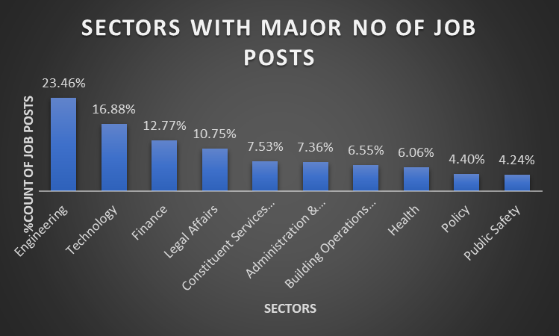
DATA ANALYSIS
Potential Sectors- Engineering, Technology & Finance
Weaker Sectors- Health, Policy & Public Safety
Maximum job posted- under Engineering Category
Minimum job posted- under Public Safety Category

Slide 8
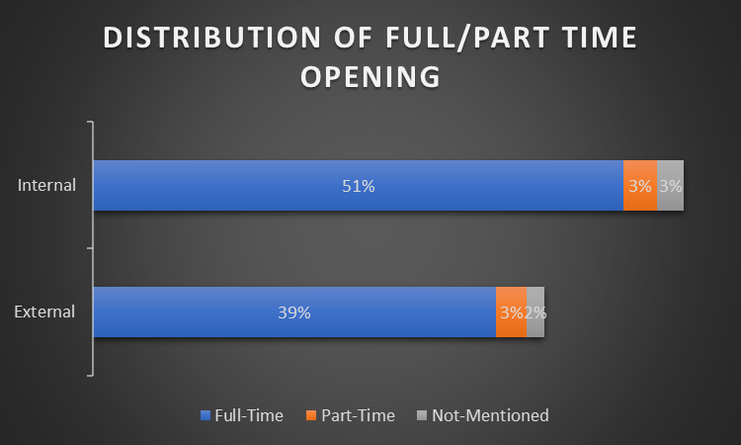
DATA ANALYSIS
Internal Full-time job opening is comparatively higher than that of external
Also, part time job opening% is negligible in comparison to that of full time

Slide 9
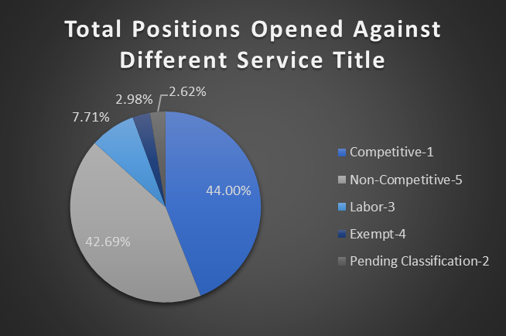
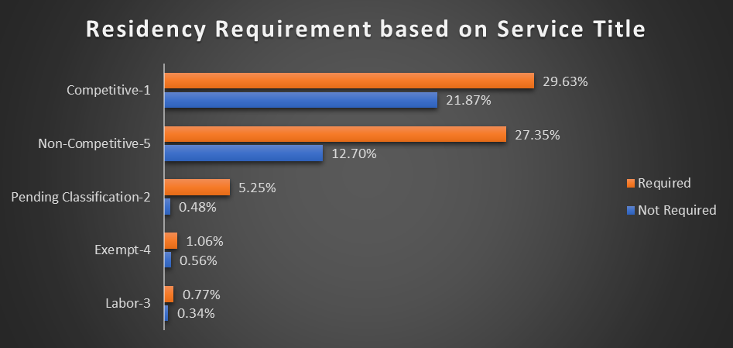
DATA ANALYSIS
Competitive and non-competitive service titles have proportionately high opening%
Competitive and non-competitive service titles demands residency requirement

Slide 10
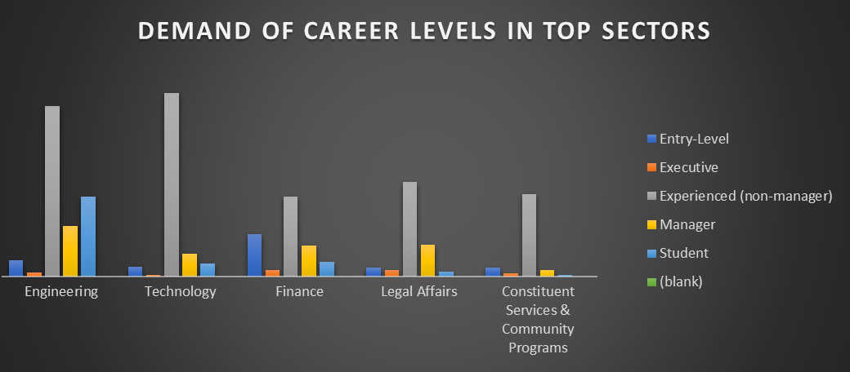
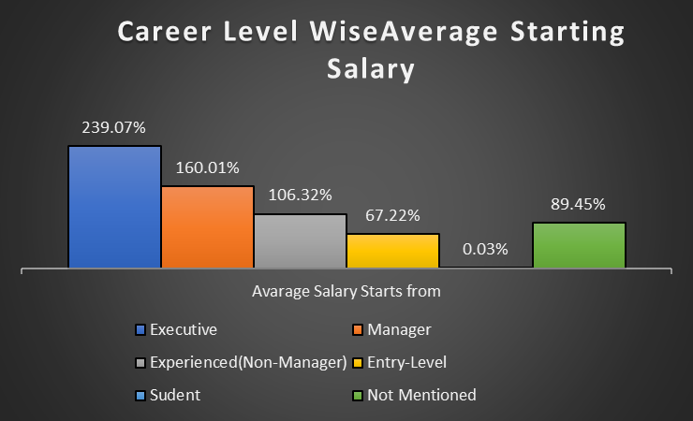
DATA ANALYSIS
Experienced (Non-Managers) have higher demand sector-wise
Executives are offered high starting salary over other career levels

Slide 11
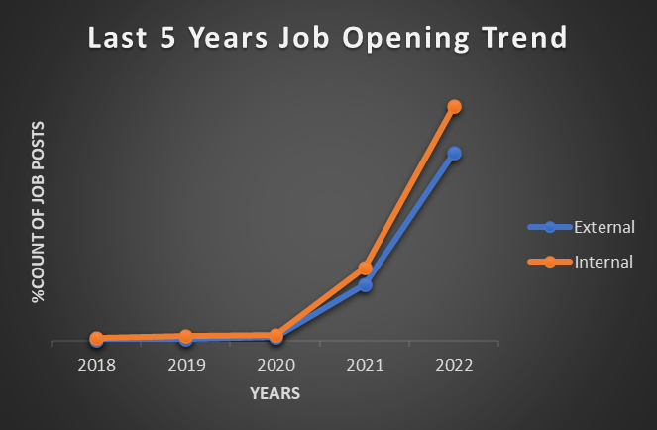
DATA ANALYSIS
2020 onwards both external & internal openings are showing an increasing trend

Slide 12
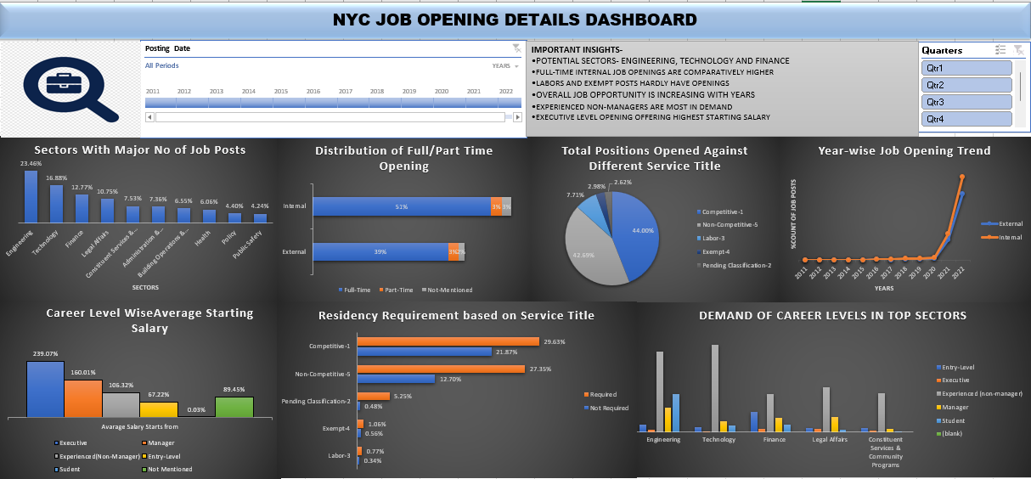
FINAL DASHBOARD

Slide 13
IMPORTANT INSIGHTS
Health, Policy and Public Safety require more resource allocation for better public service
Part time job should be increased as it enhances scope for students who required jobs while pursuing studies
Apart from experienced managers and non-managers entry-level people needs to be more encouraged sector-wise to enhance the overall employment of NYC
More the fresh talents are welcomed by different sectors more diverse will be the workforce

Slide 14
IMPORTANT INSIGHTS
As students are offered minimum starting salaries, incentives should be introduced for good performers to ensure retention
Opening for labor positions need to be increased to strengthen the socio-financially weak sector
Internal opportunities will be more than that of external in the coming years as per the trend
Residency requirement is relevant so far.

Slide 15


